Slide 1







TN Police Hackathon
Team Name : TANA
Team Members : Adithya V
Tejaswini Uma Sudhir Abhijith Ajith Nakshathra
Team Mentor :
Dr. KB Sundharakumar, Assistant Professor,
Department of Computer Science, Shiv Nadar University Chennai

Slide 2


Introduction
Our project focuses on developing methods to extract text and relevant media from VoIP and Telegram traffic to aid law enforcement agencies in criminal investigations.
The extracted data is further analyzed to determine the polarity and subjectivity which helps filter out people who send malicious content. The offender's name, ip address, geolocation are tracked to reach the criminal.

Slide 3
Problems
The increasing use of VoIP and Telegram for communication has created new avenues for cyber crimes. This has posed a new challenge for law enforcement agencies in investigating criminal activities.
Circulation of malicious and explicit content has become prevalent in the recent times due to the existence of multi- media sharing platform like Telegram.
Emerging use of techniques like VoIP has lead to many complaints of threatening calls.
These calls have become wide spread due to the anonymity these services provide

Slide 4
TANA SOLUTIONS
Message Scrapping
Media Extraction
VoIP Call Recordings to Text
IP Address Tracker
Geo-
Location Tracking

Slide 5
Streamlit
Telethon API
Mails Phishing Links
TextBlob
Asyncio
Python
Text Tracing
Filtering extracted text - NLP Sentiment polarity Sentiment subjectivity
Media Extraction
Telegram Client
Streamlit Scrapping Media Files
Telethon API

Slide 6
Streamlit
Openai
Whisper
Pandas
Uploading mp3 file
Geolocation
Json
IP-API
Voip Call Recordings to Text
Transcribing mp3 to text
Natural Language Processing on Text
Maps and Addresses

Slide 7

Text and media from Telegram groups are extracted using Telethon and TelegramClient and names of offending parties are brought into a dataframe that can be downloaded as a
.csv file
The offending parties are watched closely and in cases of repeated offence their IP address can be tracked via proper permissions from Telegram or through phising links.
Methodology
Recorded calls are transcribed and they are further analysed using NLP techniques

Slide 8









API's and Frameworks used
We have used python programming language along with the API's and other frameworks such as:
Streamlit (Application) HTML & CSS
TextBlob (NLP)
IP-API (Geolocation API) Telegram API with Telethon
Openai Pandas json aysncio os

Slide 9
ARCHITECTURE

Slide 10

Innovation and Impact
Creating a comprehensive dataset of various data types for research, analysis, and development of VoIP/Telegram-related applications
Addressing the critical need for law enforcement agencies to access relevant data with the help of NLP while considering the privacy implications of the data collection process.
Assist law enforcement agencies in criminal investigations by providing relevant information about VoIP and Telegram communications.
Identify and track suspects, gather evidence, and build cases against individuals involved in criminal activity.
Potential to make a significant impact in the field of law enforcement and digital forensics.

Slide 11
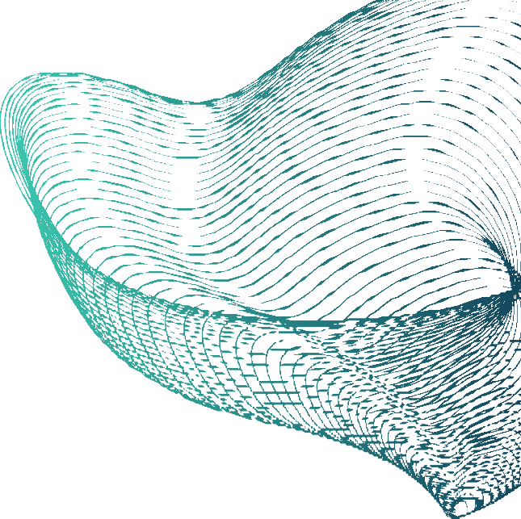
Conclusion
The implementation of the VOIP/Telegram scraping and geolocation finding application for investigative agencies can be considered a success when it enables them to efficiently and effectively gather relevant data and location information to uncover valuable insights and evidence that may aid their investigative purposes.
However, it is important for such applications to be used ethically and within the bounds of the law to ensure that the rights of individuals are respected. Ultimately, a well-designed and properly executed application can provide valuable support to investigation agencies in their efforts to uphold justice and maintain public safety

Slide 12
THANK YOU
FOR THE OPPORTUNITY AND YOUR TIME !

